Slide 1
Getting Started With Angular Chapter 3: Modules
Tushar Raj
Gaurav Sharma

Slide 2
Angular Modules
Angular apps are modular and Angular has its own modularity system called NgModules.
NgModules are containers for a cohesive block of code dedicated to an application domain, a workflow, or a closely related set of capabilities.
They can contain components, service providers, and other code files whose scope is defined by the containing NgModule.
They can import functionality that is exported from other NgModules, and export selected functionality for use by other NgModules.

Slide 3
Routing Module
Ingredients:
The <base> tag
(set <base href="/"> in index.html)
Router imports
import { RouterModule, Routes } from '@angular/router';
//
imports: [ RouterModule.forRoot( appRoutes) ],

Slide 4
Routing Configuration
const appRoutes: Routes = [
{ path: 'home', component: HomeComponent },
{ path: 'profile/:id', component: ProfileComponent },
{ path: '', redirectTo: '/home', pathMatch: 'full' },
{ path: '**', component: PageNotFoundComponent }
];
The router uses a first-match wins strategy when matching routes, so more specific routes should be placed above less specific routes.
In the configuration above, routes with a static path are listed first, followed by an empty path route (''), that matches the default route.
The wildcard route (**) comes last because it matches every URL and should be selected only if no other routes are matched first.

Slide 5
Router outlet and links
Ingredients:
<h1>Angular Router</h1>
<nav>
<a routerLink="/home" routerLinkActive="active">Home</a>
<a routerLink="/profile" routerLinkActive="active">Profile</a>
<a routerLink="/signin" routerLinkActive="active">Sign In</a>
<a routerLink="/signup" routerLinkActive="active">Sign Up</a>
</nav>
<router-outlet></router-outlet>

Slide 6
Forms Module
Angular has two approaches to building forms:
Template-driven forms: Easier to create, but not as robust. Useful when a basic form is needed.
Model-driven aka Reactive forms: More scalable and reusable. Useful for important, feature-rich forms.

Slide 7
ngModel
The [(ngModel)] syntax enables two-way binding.
A name property is required by Angular forms to register the control with the form.
Defining a name property is mandatory when using [(ngModel)] in combination with a form.

Slide 8
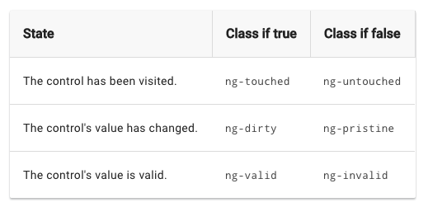
ngModel
The NgModel directive doesn't just track state; it updates the control with special Angular CSS classes that reflect the state.

Slide 9
ngForm
Angular automatically creates and attaches an NgForm directive to the <form> tag
The NgForm directive supplements the form element with additional features.
It also has its own valid property which is true only if every contained control is valid.

Slide 10
ngSubmit
Angular fires an event called ngSubmit when the form is submitted. We can bind it to a method we want.
The event is fired when a button of type submit is clicked. It's also fired when you hit enter on some types of form fields.

Slide 11
Model-driven forms
Reactive forms, or model-driven forms, take longer to set up, but they have advantages.
Complex validation is easier in reactive forms.
Unlike template-driven forms, these forms are immutable. This means that for every modification, they return a new value, instead of updating the same value.

Slide 12
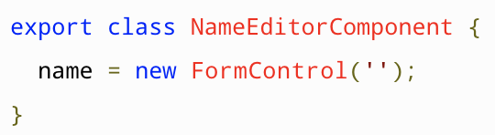
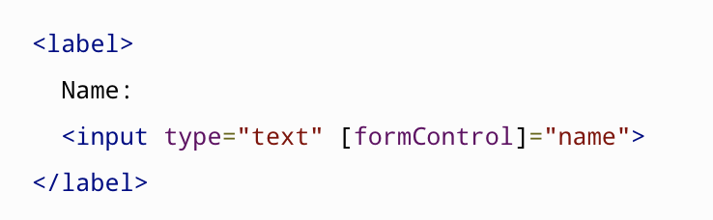
FormControl
The FormControl class is the basic building block when using reactive forms.

Slide 13
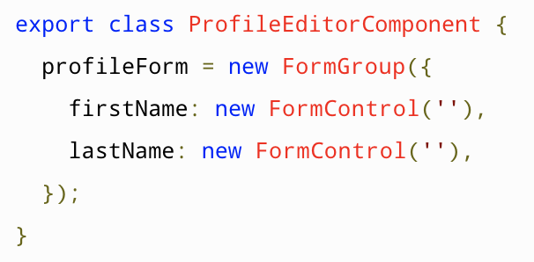
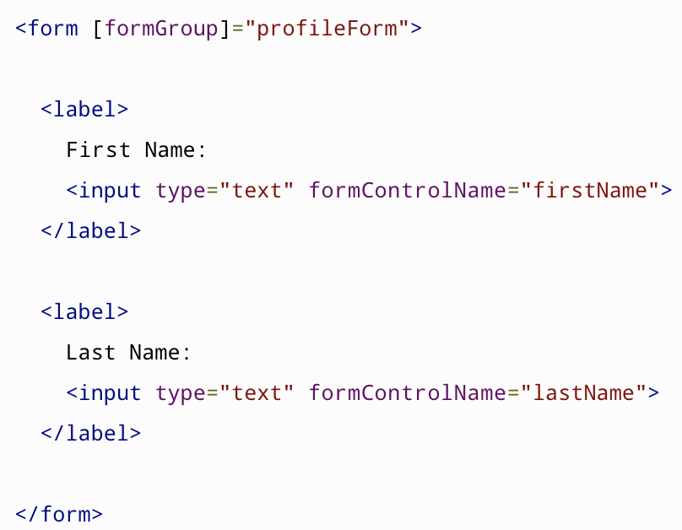
FormGroup

Slide 14
FormBuilder
The FormBuilder service provides convenient methods for generating controls.

Slide 15
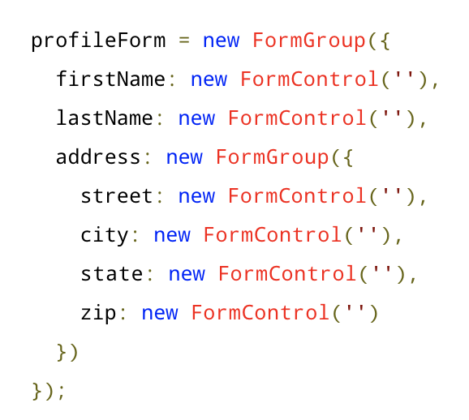
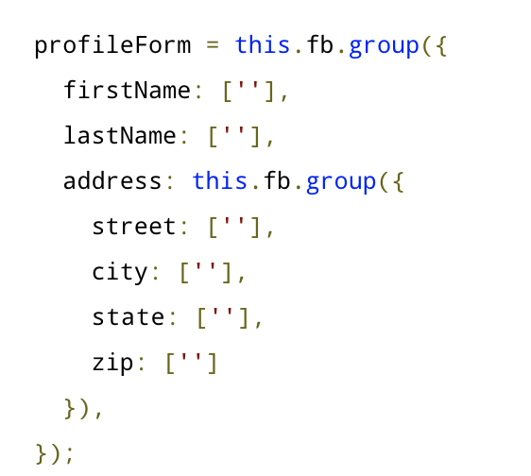
FormGroup

Slide 16
Validation
Angular provides a lot of built-in validators, which include validators based on HTML5 attributes.
You have to import the Validators class to use them.
A validation function returns null if the validation passes. If it fails, it returns an error object that can be used in the template to show specific messages.

Slide 17
HTTP module
Import the Angular HttpClientModule. Most apps do so in the root AppModule.
Inject the HttpClient into an application class
HttpClient has methods corresponding to the HTTP verbs:
get()
post()
put()
delete()

Slide 18
HttpClient
The HttpClient offers a simplified client HTTP API for Angular applications that rests on the XMLHttpRequest interface exposed by browsers.
Additional benefits of HttpClient include typed request and response objects, interception and streamlined error handling

Slide 19
Route Parameters
Configuration:
{path: 'profile/:id', component: ProfileComponent,},
Link:
<a [routerLink]="['profile', currentUser]">Profile</a>
Navigation:
this.router.navigate(
['/profile', this.signinForm.username]
);

Slide 20
Activated Route
The route path and parameters are available through an injected router service called the ActivatedRoute
After the end of each successful navigation lifecycle, the router builds a tree of ActivatedRoute objects

Slide 21
Activated route properties
url
paramMap, queryParamMap
Outlet: The name of the RouterOutlet used to render the route. For an unnamed outlet, the outlet name is primary.
parent, firstChild, children

Slide 22
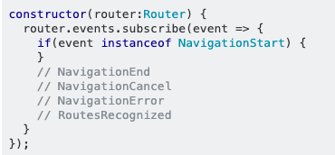
Router Events
NavigationStart, NavigationEnd
NavigationCancel, NavigationError
ActivationStart, ActivationEnd
GuardCheckStart, GuardCheckEnd

Slide 23
Route Guards
A guard's return value controls the router's behavior:
If it returns true, the navigation process continues.
If it returns false, the navigation process stops and the user stays put.
It can also return a 'UrlTree'
We'll look at two of the route guards:
CanDeactivate: handling unsaved changes
CanActivate: requiring authentication

Slide 24
More to Discover
Lazy loading a feature module
Angular animations
Angular Dependency Injection and navigating the component tree.
Unit-testing with Jasmine
E2E testing with Protractor
The MEAN stack (Mongo, Express, Angular and Node).

